Slide 1
Accessible by Default, Inclusive by Design
The Digital Academy - Design Stream

Slide 2




Intro
Hey there! I’m Julianna. I work on helping the Canadian Digital Service create accessible and inclusive services for Canadians.
julianna.rowsell@cds-snc.ca
https://github.com/jrowsell
@juliannarowsell

Slide 3
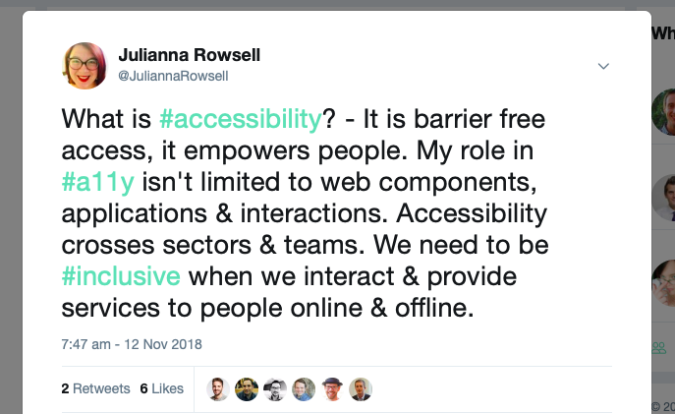
What is my role?

Slide 4
The Government of Canada can be a leader in accessibility and inclusive design
Notes:
Accessibility has a reputation for being hard and sometimes even unobtainable. But building inclusive services that work better for everyone isn’t about perfection. It’s about making an effort and seeing progress. When we bring that type of effort every day, transformation happens. On the flip side, when we don’t, the people who may need our services most can’t access them.

Slide 5

Inclusive Design
Inclusive Design is design that considers the full range of human diversity with respect to ability, language, culture, gender, age and other forms of human difference.

Slide 6

Accessibility
Disability is the mismatch between the needs and preferences of the user and the system or environment. Accessibility is the ability of the system of environment to accommodate the needs and preferences of the individual.

Slide 7
Are the Government of Canada’s products and services required to be accessible?
Notes:
A backgrounder on accessibility in the Government of Canada, the court decision regarding the appeal in the Donna Jodhan case circa 2012. It covers the background, facts & requirements. If you are new to accessibility in the Government of Canada or are indirectly involved in accessibility this is a good place to start. https://bit.ly/2S94ALq "The act will benefit all Canadians, especially Canadians with disabilities, by proactively identifying, removing and preventing barriers in a number of priority areas, while also setting accessibility standards and regulations." - Minister Carla Qualtrough Bill C-81 the Accessible Canada Act went through it's second reading in the senate today. This bill would establish the Canadian Accessibility Standards Development Organization and the position of Chief Accessibility Officer, who would advise the minister on emerging and systemic accessibility issues in Canada.

Slide 8
The Web Content Accessibility Guidelines or (WCAG) is a set of guidelines for making content accessible for all people, including those with disabilities.
Notes:
The Government of Canada has been required to meet WCAG 2.0 AA since 2012 after a court decision in the Donna Jodhan vs. Attorney General.

Slide 9
Web Content Accessibility Guidelines
Outlines best practices for making web content universally perceivable, operable, understandable, and robust.
Defines criteria for successful inclusive web design, with ascending levels of compliance (levels A, AA, and AAA).
Is composed and reviewed by a global community of digital experts.
Connects the world through common information technology and user experience standards.
Notes:
WCAG 2.0’s essential design concepts are labeled perceivable, operable, understandable and robust.
Designers and developers are asked to meet all four of these principals for disabled users, and then select a degree of compliance (Level A, AA, or AAA).
The four design principals are defined as follows:
Perceivable: Information and user interface components must be presentable to users in ways they can perceive. This means that users must be able to perceive the all relevant information in your content.
Operable: User interface components and navigation must be operable. This means that users must be able to operate the interface successfully.
Understandable: Information and the operation of user interface must be understandable. This means that users must be able to understand the information as well as the operation of the user interface.
Robust: Content must be robust enough that it can be interpreted reliably by a wide variety of user agents, including assistive technologies. Content must be accessible to all users, keeping up with advances in technology, such as mobile technology.

Slide 10
Meeting government accessibility requirements
Digital Products/Services in the Government of Canada must meet WCAG 2.0 AA. CDS has adopted and is striving to meet WCAG 2.1 AA. (Released in June 2018 and already adopted officially by the UK, Australia and Japan.

Slide 11
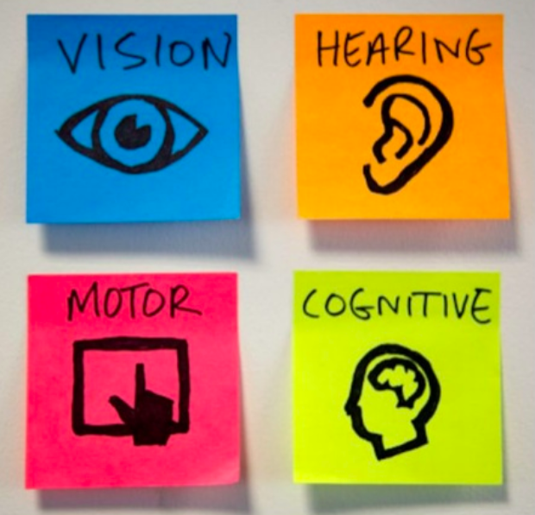
Globally 1-5 people have a disability
Build for all users, with different needs at different times in different circumstances.
Location
Health
Equipment (devices, etc)

Slide 12
Accessibility is about making sure your service can be used by as many people as possible.

Slide 13
Accessibility doesn’t have to be overwhelming
Build accessibility into the beginning of a product. Not only will it save time, but also resources.
Shorten update/release change process by clearing hurdles and lengthy approvals.
Reach out and include persons with disabilities throughout product discovery, design, development, and delivery phases.
Build awareness on the product teams in order to improve the service. Encourage delivery team members to engage within the community, being open to feedback and striving to make things better.
Embed accessibility champions on product teams in different roles to improve reach, awareness, and understanding of accessibility issues.
Notes:
The key is people need to know what to consider, what to be aware of, and what to flag.

Slide 14
Start considering accessibility early
Discovery | Alpha | Beta | Live
Finding out what the users need, what to measure and what the constraints are | Building a prototype, testing it with users and learning from it | Scaling up and going public | Learning how to continuously improve the service

Slide 15
These principles are building blocks that link accessibility, inclusion and diversity.

Slide 16
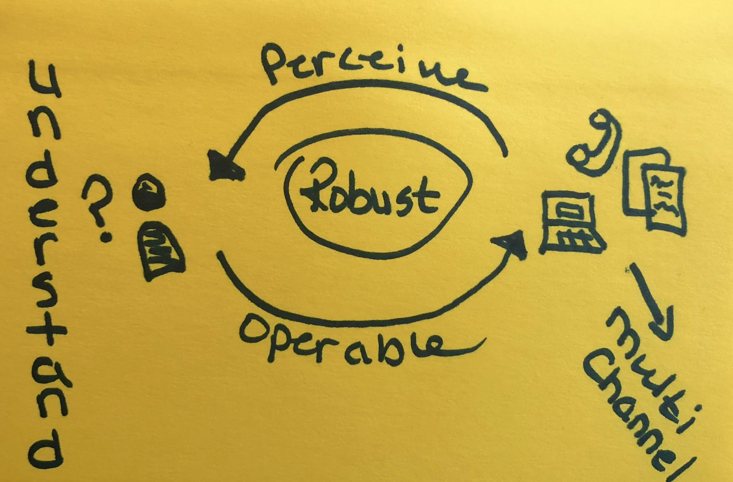
Inclusive Design Principles
built around accessibility principles
Notes:
Accessibility doesn’t have to be hard. If you consider it at the beginning of your project as early as in the discovery phase you will position your project to be more inclusive simply because it was “baked” into the project. Think of this like baking a muffin, if you are making a blueberry muffin it’s difficult to add the blueberries after it’s finished baking, and it you try to bolt them on after the fact it’s not going to look pretty, stick together or work in ways that you would expect.
This doesn’t mean we can’t use the latest and greatest tech, if just means we have to build with specific caveats in mind on what we need to consider, how we can do it as inclusively as possible while addressing accessibility related requirements that are driven by providing great user experience.

Slide 17
What can we plan to do to help improve the human experience of digital services?

Slide 18
Route Map for Accessibility
Our route map for accessibility:
Do design research with people
Include persons with disabilities throughout the process
Be pragmatic, go forward with accessibility in mind, take corrective measures as needed
Build capacity in inclusive practices
Prioritize change, consider impact, reach, modernization, requests/analytics, and feasibility
Assign budget (it’s necessary, worthwhile, and the law)
Tap into expertise across government
Plan for continued progressive improvement Goal: Make it better than it was yesterday.

Slide 19
Accessibility is everyone’s Responsibility

Slide 20
Accessibility is multidisciplinary
Content creator (client/partner)
Designer
Developer
User Researcher
Product Manager
Policy
SME’s

Slide 21
The usual approach to accessibility is a problem
No one thinks about accessibility...except the accessibility expert.
Accessibility comes at the end of development...by testing done by the accessibility expert.
All issues found are directed to developers to fix...with help from the accessibility expert.
Result: “Sort of” accessibility + $$$ and time.

Slide 22
How to make an existing content or service accessible
Make accessibility part of your design research
Test with users with diverse needs
Use automated testing tools
Hire an accessibility subject matter expert to give you advice
Test your product or service manually for accessibility
Conduct an accessibility audit
Make the required fixes
Notes:
Get an Accessibility Audit. Use an audit service to find out if your product works with assistive technologies and meets WCAG 2.0 level AA. Use the audit results to fix problems and do another test.
Appoint an Auditor. You can appoint someone in your company to do recurrent accessibility audits. This could be someone in your QA team. If you don’t have someone with the experience, you can hire an external supplier.
Make accessibility part of your design research. When doing research verify if your assumptions concerning accessibility were right and if there are any potential opportunities to improve. Recruiting people with disabilities requires a bit more work. Don’t hesitate to contact associations, and communities—people are willing to help.

Slide 23
Accessibility Misunderstanding
A last pass
Bolted on
A feature
A “Mysterious” process
A Unicorn
Special Code
Magic pixie dust
Limited to one person
Like usability, accessibility should be built in at the start. It’s poorly functioning as an afterthought.

Slide 24
Why is accessibility hard?
Little design choices made without understanding accessibility issues and criteria - they add up and lead to inaccessible services.
How do we do better?
Research guidelines
Ask Questions
Follow the answers
Analyse the results
Repeat until insight

Slide 25
Possible solutions
Champion accessibility
Everyone works towards it
Education on how choices impact accessibility
Utilize existing expertise of team members
Goal
Maximize accessibility expertise
Reduce time required to deliver accessible products
Prevent issues before they happen
Identify and resolve early
Improve overall accessibility and strive to exceed

Slide 26
Pragmatic accessibility
It is inexact
Pragmatism is not perfection
Continuous improvement is crucial
Iteration aids this process
Perfect accessibility is subjective
Who benefits? Vision, hearing, motor, cognitive.
Who else? Users of smartphones and tablets, users in brightly lit rooms, rural people, impatient people, people who are situationally impaired, injured people, everyone.

Slide 27
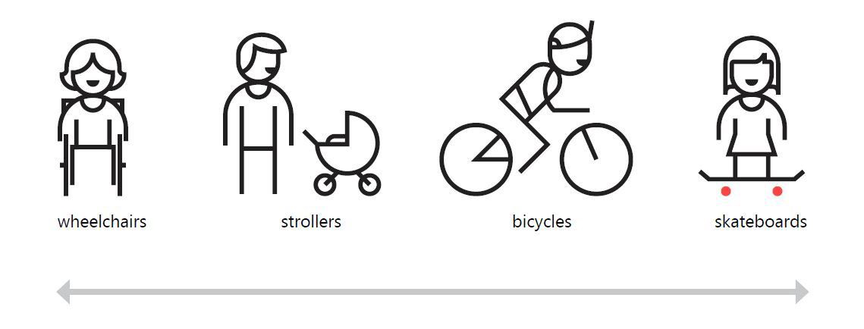
We all can be considered disabled in some scenarios
Notes:
We all can be considered disabled in some scenarios. When driving a car, touch interaction is impaired. Everyone can benefit from inclusive voice-control (assistants like Cortana or Siri for example). Having a newborn on your hands? You’re limited to one hand for interaction with a smartphone. You are disabled. Temporarily. My favorite example are curb cuts for easier and safer crossing the street on a wheelchair. It is mainly for people with permanent disabilities and can seem like a significant design constraint, but… it actually also helps people with strollers, kids on a bicycles or can save you from injury. Inclusive design is simply better design.

Slide 28
Empathic accessibility
How do people get info?
What is the barrier?
Who does adaptive technology work for?
For the person:
Dignity, respect, empowerment. Start a conversation with a person with a disability, be open minded and listen.

Slide 29
Inclusive design and accessibility should be considered at every phase and stage of the service development
Notes:
Remember that inclusive design should be a part of every stage of product development. Inclusive design needs to be considered at every stage when building a product, including strategy, design, and development, highlighted Sarah Federman, a design engineer at Adobe. “At the design stage, we need to consider things like documenting expected keyboard interaction and reading order, color contrast, and text and media accessibility,” she recommended. “Project managers need to be tracking this and developers need to know how their app should behave—not just how it looks. It's a shared responsibility across the entire organization.” If you do an amazing job documenting keyboard accessibility but a developer never sees it or it was implemented incorrectly, your work ends up having little value for your end users. Communication and follow-through is really key to delivering a great inclusive experience. “If you do an amazing job documenting keyboard accessibility but a developer never sees it or it was implemented incorrectly, your work ends up having little value for your end users. Communication and follow-through is really key to delivering a great inclusive experience.”

Slide 30
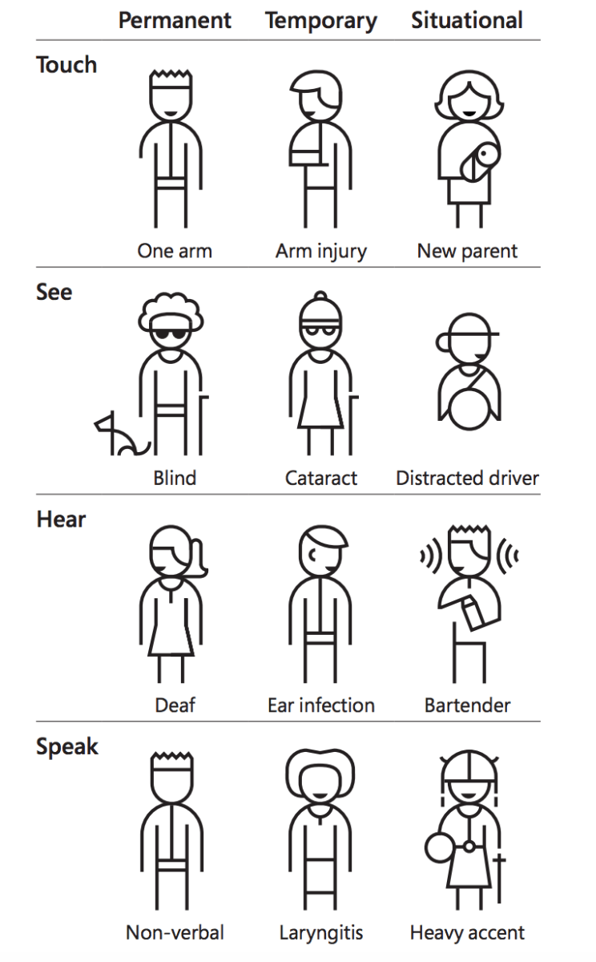
Recognise exclusion
“Disability is not just a health problem. It is a complex phenomenon, reflecting the interaction between features of a person’s body and features of the society in which he or she lives.”
–World Health Organization
Notes:
Solve for one, extend to many
A solution that works well for someone might also benefit other persons. Inclusive design works across a spectrum of related abilities, connecting different people in similar circumstances. For instance a solution designed for people with one arm might help people with an arm injury or a new parent who has situational disability to use both the hands.

Slide 31
Learn from diversity
People adapt to diversity in unexpected ways. Putting people in the centre of the design process from the start lets us to gather valuable insights which would not have been considered else.

Slide 32
Solve for one, extend to many
A solution that works well for someone might also benefit other persons. Inclusive design works across a spectrum of related abilities, connecting different people in similar circumstances. For instance a solution designed for people with one arm might help people with an arm injury or a new parent who has situational disability to use both the hands.

Slide 33
The Problem With Good Design: Why Good Design Isn’t Good Enough
Notes:
The truth is that “good design” considers the best form and function for some people, but excludes many people on the basis of ability — and individuals with disabilities are often left out. We want to change that.
Design should be inclusive, bringing more people in instead of shutting them out. We believe that design shouldn’t discriminate or divide us up, but bring us together.
Individuals with disabilities should have equal and integrated access to quality products, services, and structures — that everyone has a right to enjoy beautiful, functional design, and that we all benefit when we enjoy design together.

Slide 34


Examples of good inclusive design
Notes:
Microsoft’s Xbox Adaptive Controller is an inspiring example of inclusive design
Every gamer with a disability faces a unique challenge for many reasons, one of which is the relative dearth of accessibility-focused peripherals for consoles. Microsoft is taking a big step toward fixing this with its Xbox Adaptive Controller, a device created to address the needs of gamers for whom ordinary gamepads aren’t an option.

Slide 35

An example of ‘bad’ inclusive design
Notes:
Combined ramp and stairs. Ramp zig zags across stairs.
I am reminded of discussions, maybe 2-3 years ago, about that combined staircase and ramp in the photo above. I think it is in Vancouver but I may be wrong (addition: thanks to Dean Birkett in the comments, it’s in Robson Square in Vancouver).
Again, it looks great.
Again, it got lots of coverage as cool design
Again, it was silly.
The practical problems were that:
for wheelchair users: it was too steep
for people with walking impairments: there were not enough handrails
for everyone: there were trip hazards
Looking cool and being usable is entirely possible but we need to point out when it doesn’t work.

Slide 36
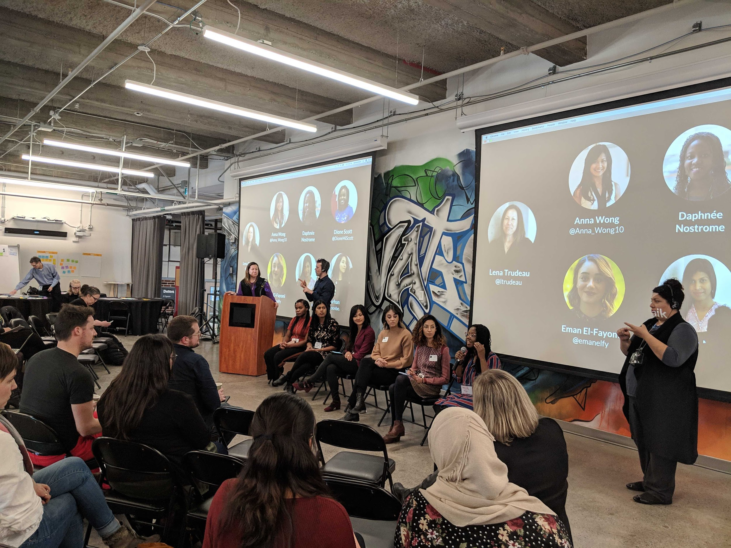
Example of Inclusive Design & Accessibility in the GC
Inclusive by design, accessible by default
French translation
Bilingual presentations
Sign language (ASL & LSQ)
CART live transcription
Audio Visual Equipment
Accessible facilities including elevators, washrooms, doors, etc.
Notes:
This created an atmosphere of inclusion which went beyond simply being able to participate. The people who attended with diverse needs shared with us that this level of accessible service design gave them a sense of belonging. This in turn allowed us to hear from voices that we would not always hear from.

Slide 37
The power of the web is in its universality. Access by everyone regardless of disability is an essential aspect- Tim Berners - Lee

Slide 38
Why should we care about making our services accessible?
Bill C-81 Accessible Canada Act (just went through the 2nd reading in the senate and is at committee)
Donna Jodhan vs. Attorney General of Canada, 2012
Standard on Web Accessibility
Digital Standards (TBS)
We have the first ever Minister of Public Service Accessibility
Public Service Accessibility Strategy
Morally it is the ethical thing to do
Builds confidence and trust

Slide 39
Let’s focus on creating new habits by championing accessibility.

Slide 40
Together we can build more inclusive and accessible services.

Slide 41
Questions?

Slide 42
Need Help?
Contact these hubs
Access Working Group (Interdepartmental working group on accessibility) Contact: ssc.aaact-aatia.spc@canada.ca
Accessibility and Inclusive Services Contact: julie-ann.rowsell@tbs-sct.gc.ca
Accessibility, Accommodation and Adaptive Technology Program (AAACT) Shared Services Canada Contact: ssc.aaact-aatia.spc@canada.ca
Web Standards - Centre of Expertise Economic and Social Development Canada Contact: NC-NW-WS-GD@servicecanada.gc.ca
Centre for Accessibility Public Service and Procurement Canada Contact: Dominique.Labrecque@tpsgc-pwgsc.gc.ca

Slide 43




digital.canada.ca
@CDS_GC
github.com/cds-snc

